Slide 1
FARMERS HELP GUIDE : DR SABITHA S
SUBMITTED BY
ANJANA PT
MCA S3
TVE20MCA-2015

Slide 2
INTRODUCTION
Farmers Help is a
Flexible software package which contains numerous potent features that makes the activities of farmer management easier than ever.
Web application intended to manage different farming requirements like crops, techniques used, selling and buying products etc.
Seven types of users interact with the project.

Slide 3
OBJECTIVE
Coordinate different events under one roof.
Customization of farming package; here the users can select the required options regarding the farming requirements.
The primary objective is to provide a fast and reliable system for farming fields and to make all the processes more efficient, speedy and secure by automating the system.

Slide 4
EXISTING SYSTEM
Currently, the farmer goes to nearest market handover his product to a particular agent, agent ask the farmer to visit the market after a specific time to collect the cash earned out of the sold product.
Agent sells the product to another agent or a dealer at the cost of that market.

Slide 5
DRAWBACKS OF EXISTING SYSTEM
There is no way for farmer to know about the deal and the exact amount at which their product was sold.
There is no transparency. No facility to know the product price in different markets where farmers can sell their products for high profit.

Slide 6
Man power is required to maintain records.
While preparing the details manually, it takes lot of time and effort
It is very slow process.
No efficient facilities for farmer management and other activities of other users.

Slide 7
PROPOSED SYSTEM
The website is a one point solution for helping farmers.
Farmers can avail capital assistance from the outset by requesting an amount from interested investors.
Then they can purchase seeds online .
The equipment for farming can be purchased from the same website.
Also the pesticides for cultivation can be purchased from the site.

Slide 8
The farmers can ask doubts from agriculture experts so that they can take better care of their crops and improve their yield.
Suppliers can add the product details like price, description, quantity to the site. They can view the bookings of their products.
Once the harvest starts, farmers can sell it online.
Thus the site provides the farmer a complete solution.

Slide 9
ADVANTAGES OF PROPOSED SYSTEM
Through a website like this, farmers can connect directly with customers and make their transactions profitable for them without a middleman/third party.
Stores the information about all users and Registered users can view and modify their profile.
Provides instant access to information.

Slide 10
USERS ARE
Farmers
Exporters
Investors
Suppliers
Specialist
Public
Admin

Slide 11
MODULES ARE
Farmers
Registration
Add crops
Purchase products
Add Farming Techniques
Chat with specialist
Request capital

Slide 12
Suppliers
Add product details
View Booking
Add Feedback
Specialists
View Enquiries
Respond to enquiries
Exporters
Add order
View products

Slide 13
Investors
Invest Money
People who want to invest in agriculture can register so they can help farmers.
Public
Registration
Purchase products
View products
Add feedback
View farming techniques

Slide 14
CONTEXT DIAGRAM / LEVEL 0

Slide 15
ADMIN
FARMER
Request
Response
Response
Request
FARMERS_HELP
SPECIALIST
Request
Response
PUBLIC
Response
Request
Request
Response
Response
Request
Response
Request
EXPORTERS
SUPPLIERS
INVESTORS

Slide 16
LEVEL 1

Slide 17
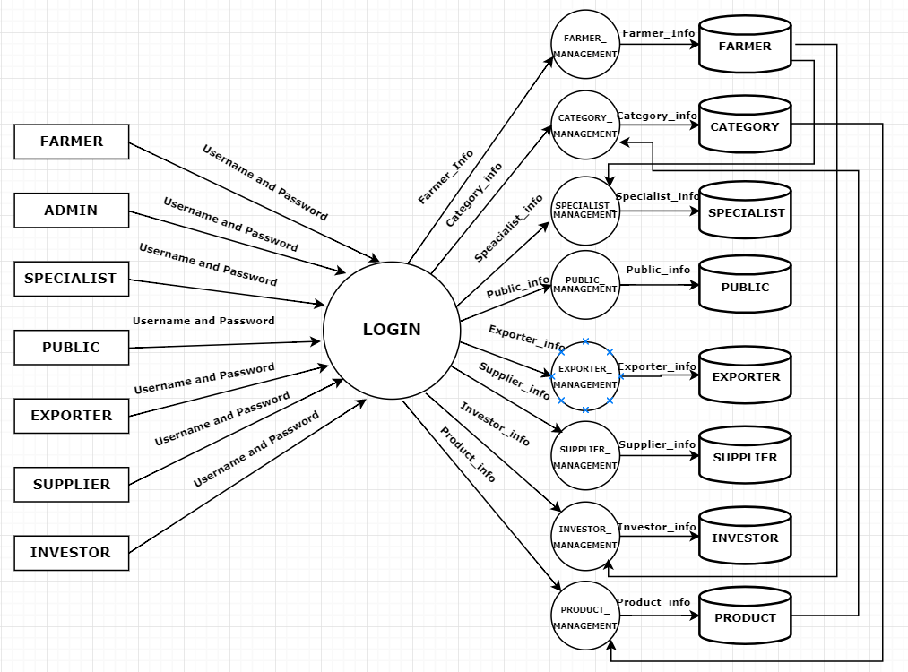

Slide 18
LEVEL 2

Slide 19
2.1 Farmer Management

Slide 20
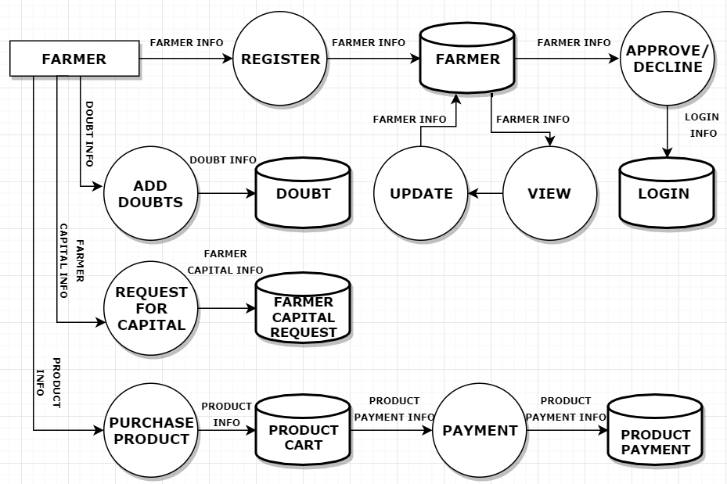

Slide 21
2.2 Specialist Management

Slide 22
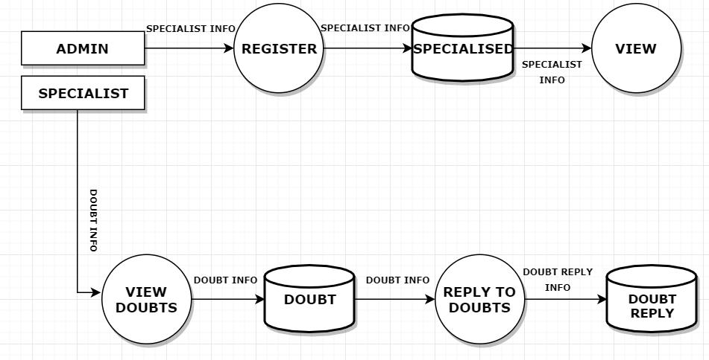

Slide 23
2.3 Public Management

Slide 24
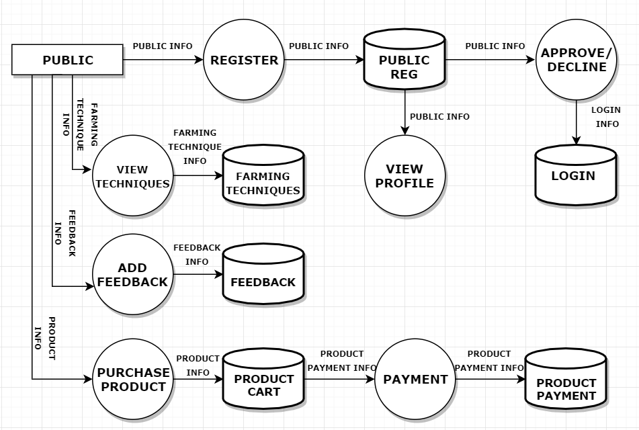

Slide 25
2.4 Supplier Management

Slide 26
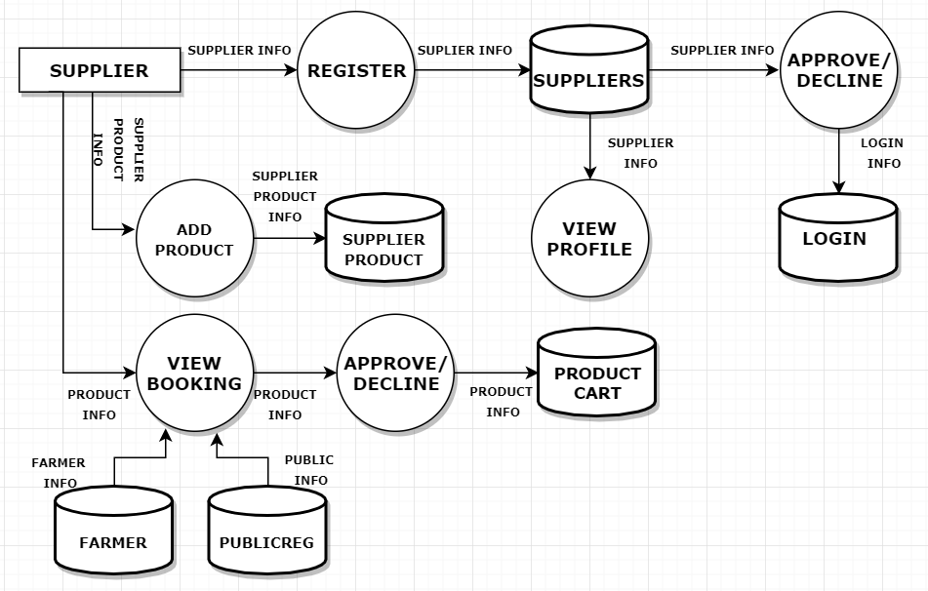

Slide 27
2.5 Exporters Management

Slide 28
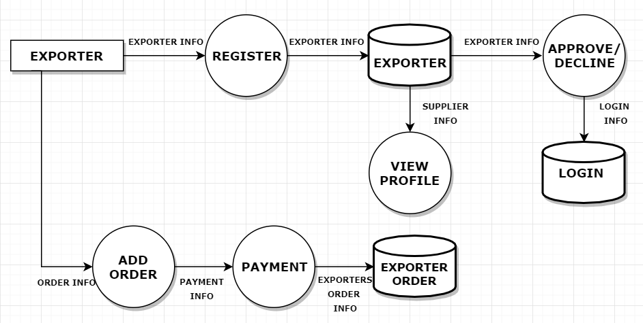

Slide 29
2.6 Investor Management

Slide 30
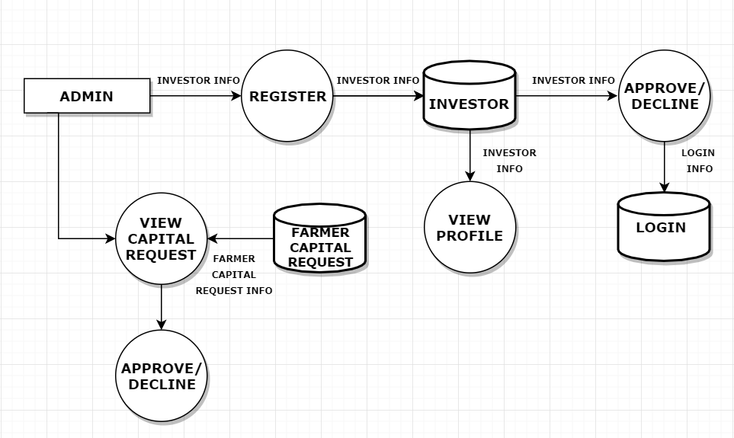

Slide 31
2.7 Category Management

Slide 32
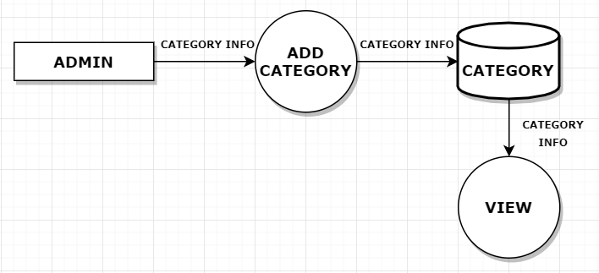

Slide 33
2.8 Product Management

Slide 34
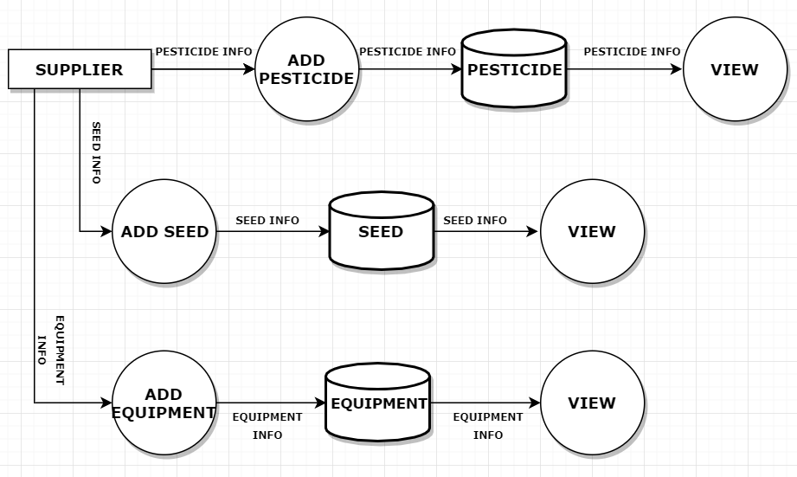

Slide 35
ER Diagram

Slide 36
supplier name
Product
name
Phone
number
Registration Code
Sup_reg
number
Provided By
name
quantity
Suppliers
Product
Suppliers
Account
number
Phone
number
email
Image
item
name
email
pub
name
productid
email
rate
cat
followupid
email
address
password
Add
Viewed By
pub
id
Buy
Technique
Public
password
Feed
back
dates
email
feed
id
Viewed By
Technique
name
name
Add
Feedback
mobile
password
status
unit
Product
id
Exp_reg_no
Farmer
id
file
email
email
rate
quantity
quantity
Account
number
name
email
Farmer
name
proof
Add
cat
pro
name
Phone
number
pro
name
Order
amount
Farmer
Products
order
id
Exporters
address
Phone
number
Invest
id
Account
number
address
amount
dates
name
Phone
number
Office
contact
Apply for
mobile
email
Given By
Investorid
Capital
Investors
email
Account
number
email
name
Ask for
Enquiries
Viewed By
Doubt
Specialist
Specialist
id
pro
name
doubt
email
replay
id
replay
dates
doubt
dates
name
doubt
id
Replay to doubt
Viewed By
pro
name
email
Phone
number
email
Doubt
replay
Specialized

Slide 37
SCREENSHOTS

Slide 38


Slide 39
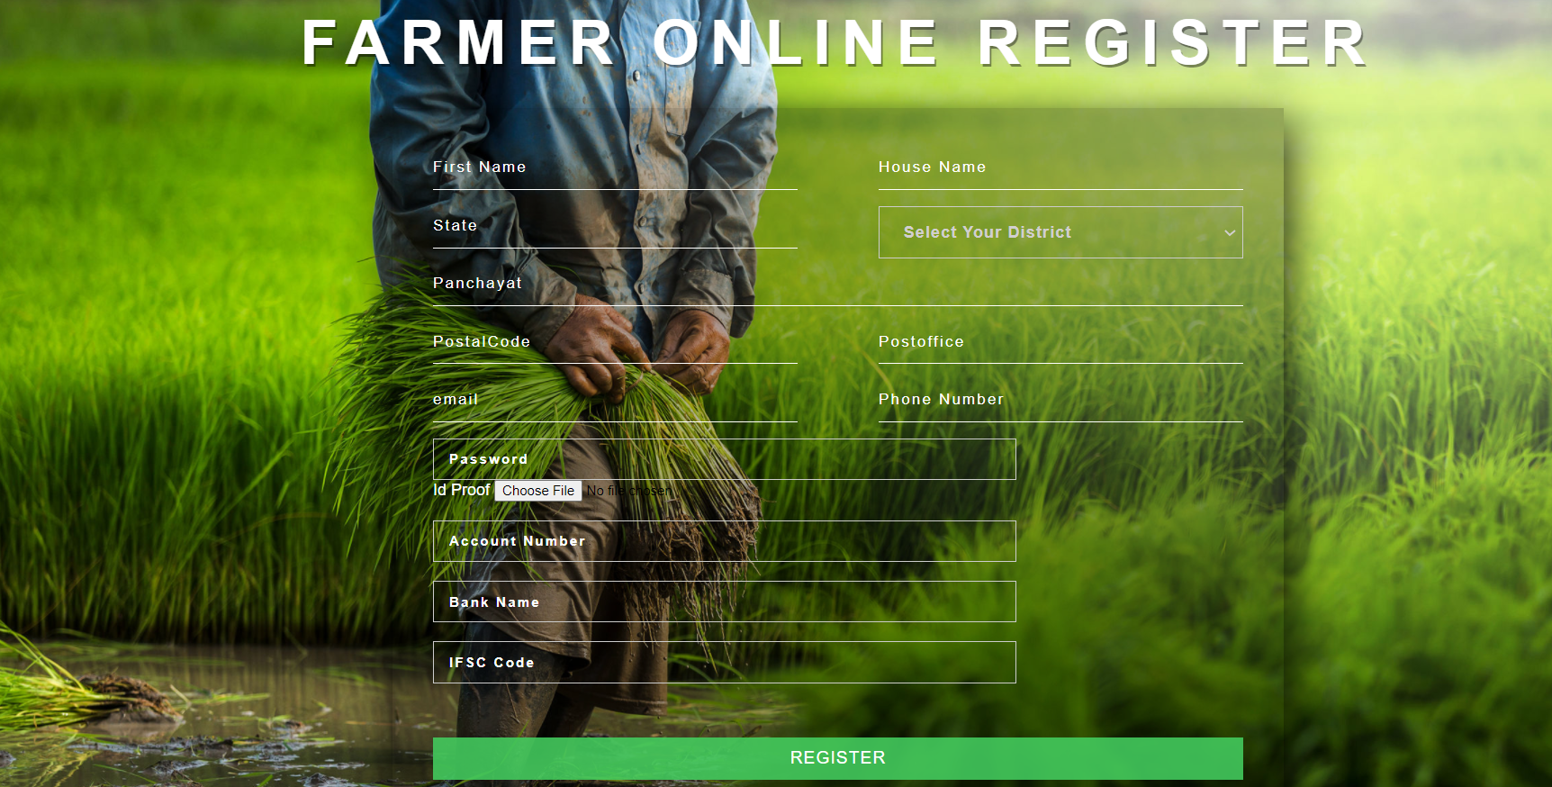

Slide 40


Slide 41
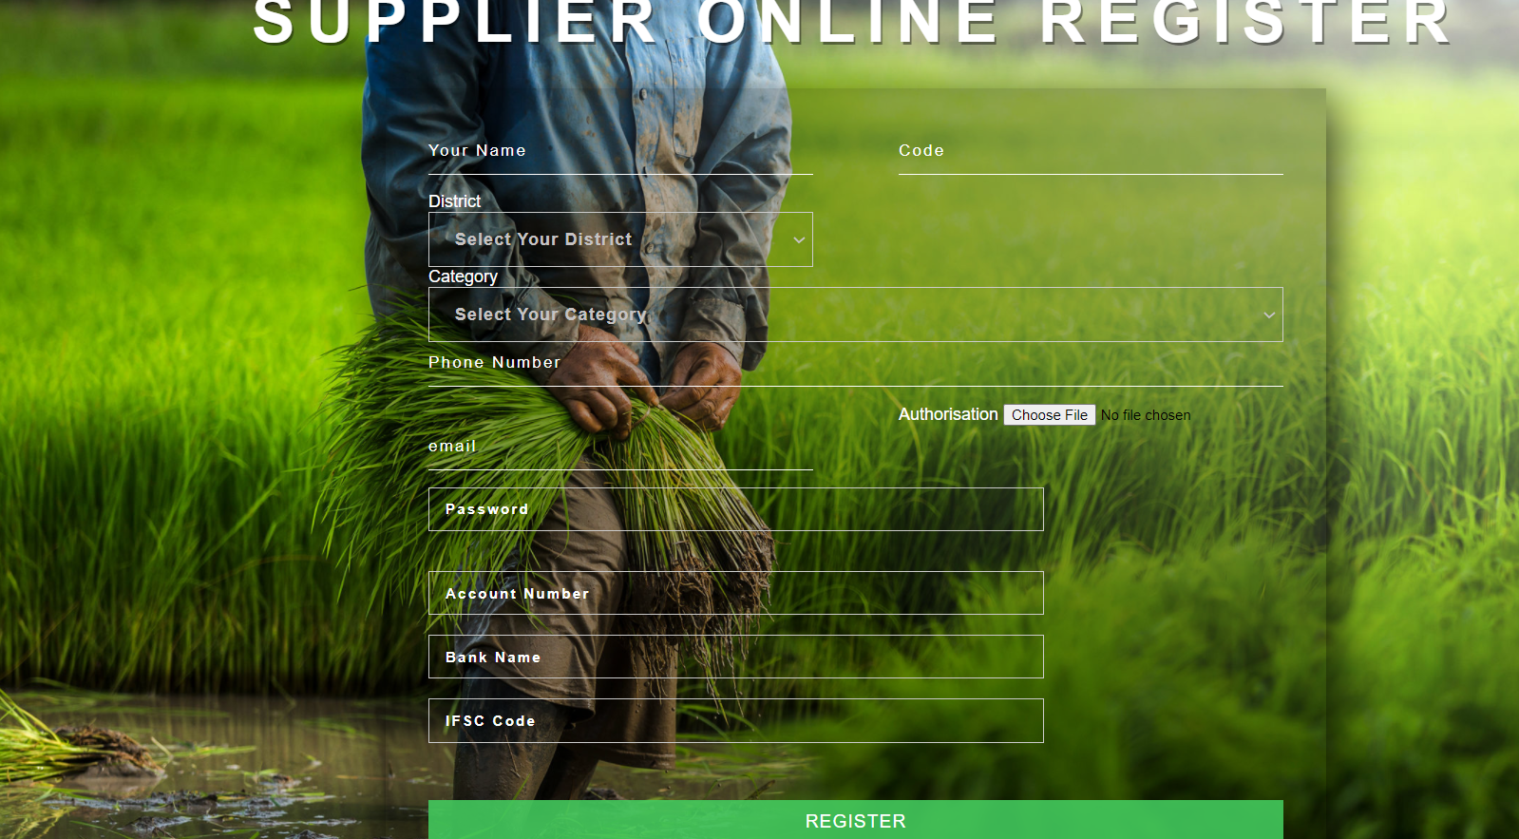

Slide 42


Slide 43
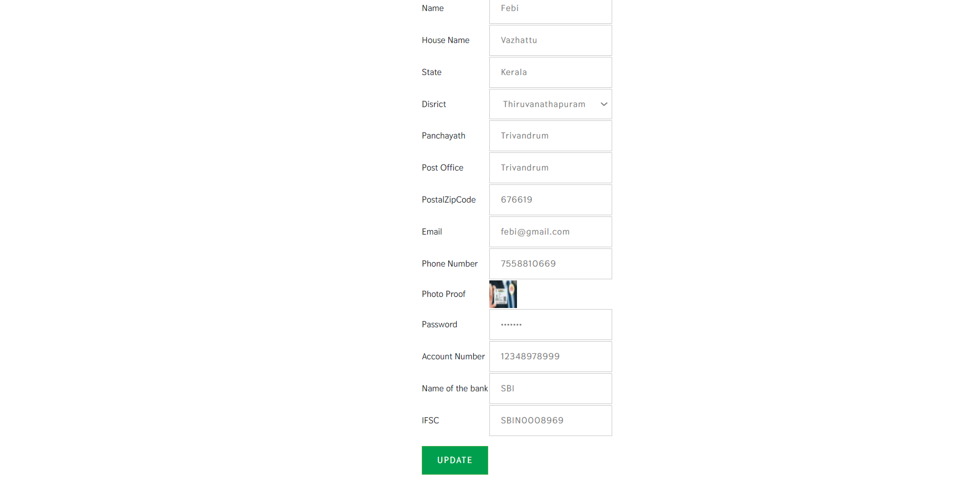

Slide 44
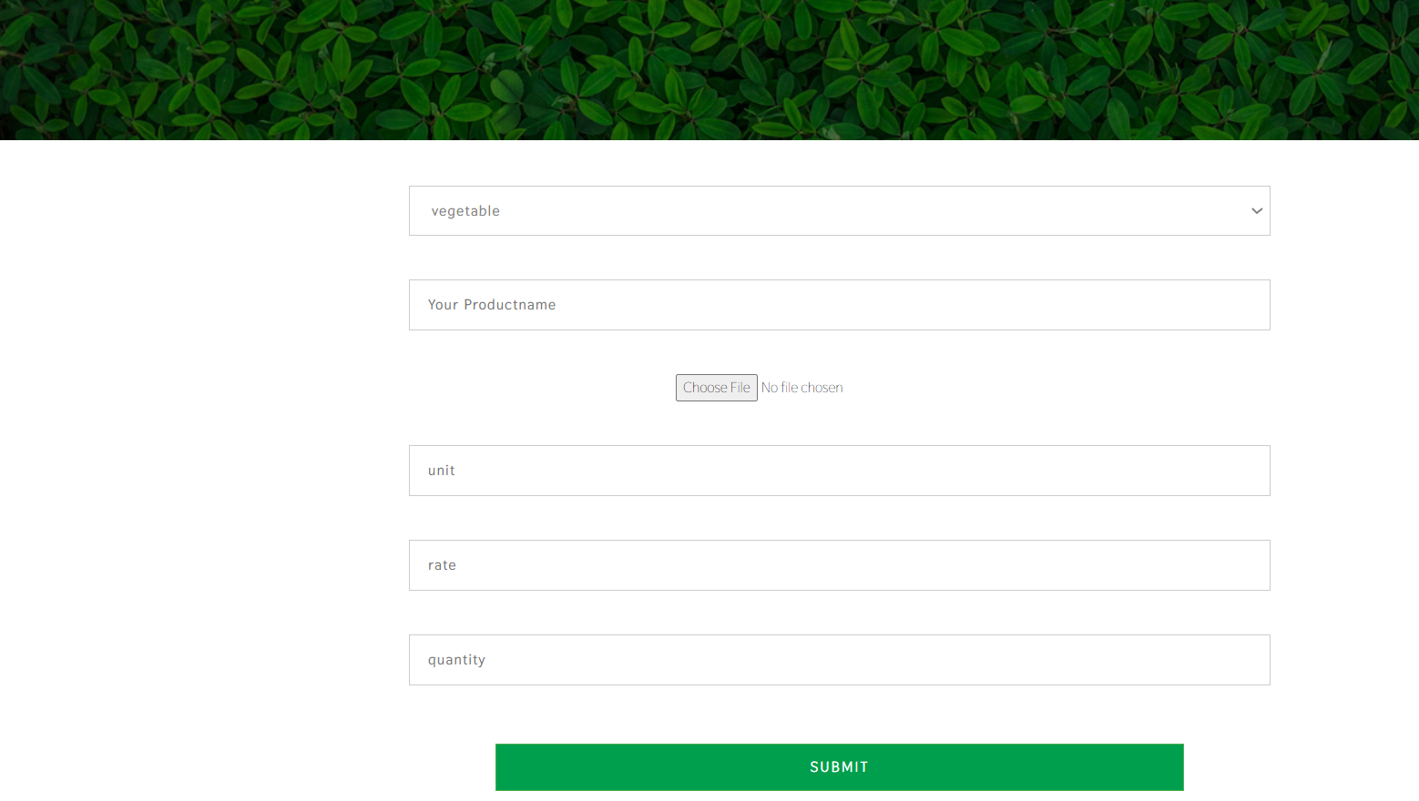

Slide 45
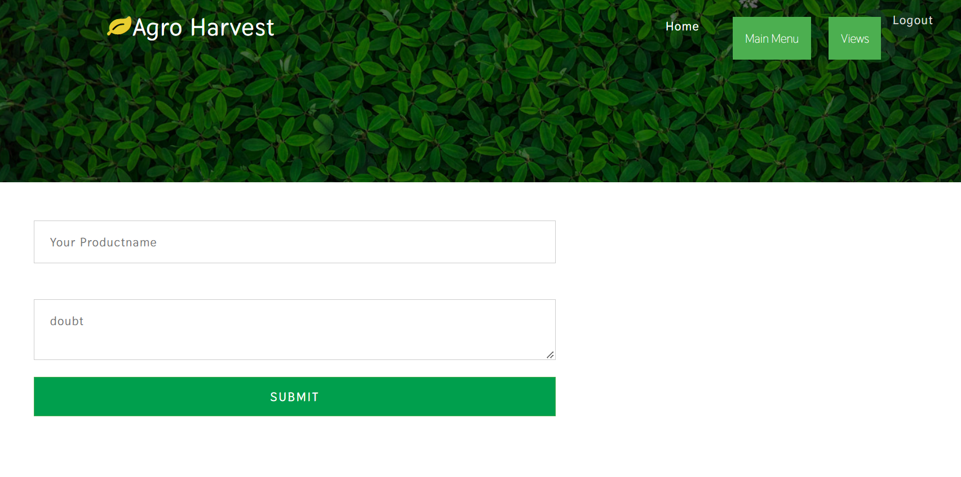

Slide 46
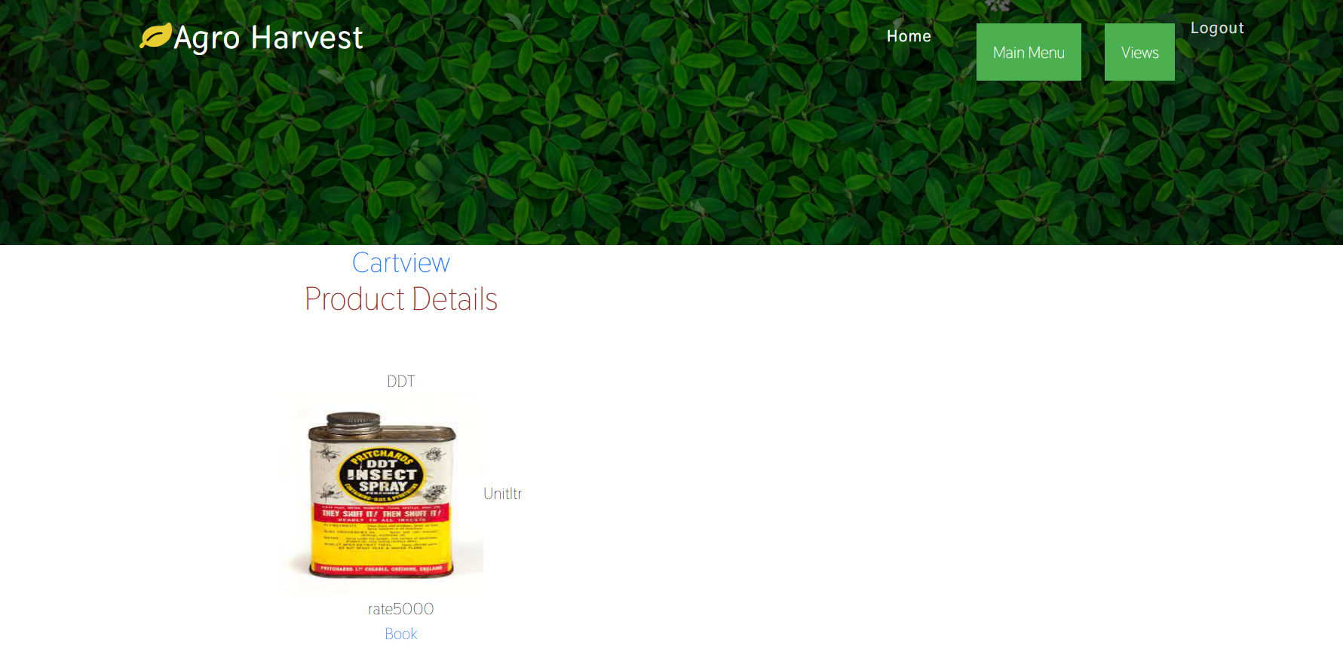

Slide 47
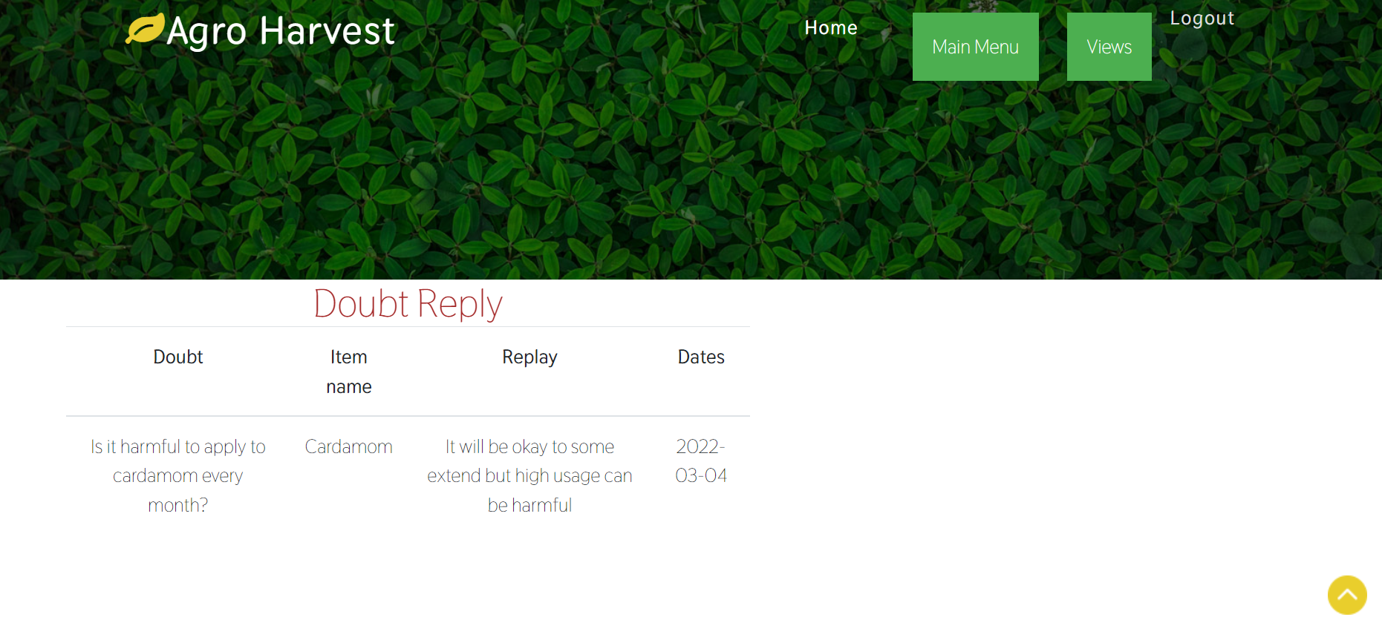

Slide 48
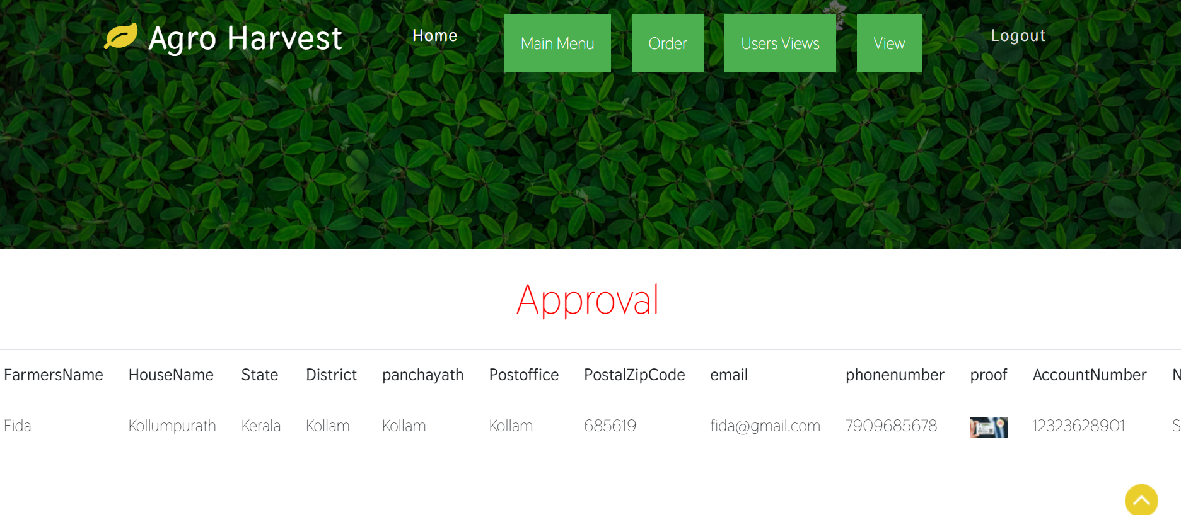

Slide 49
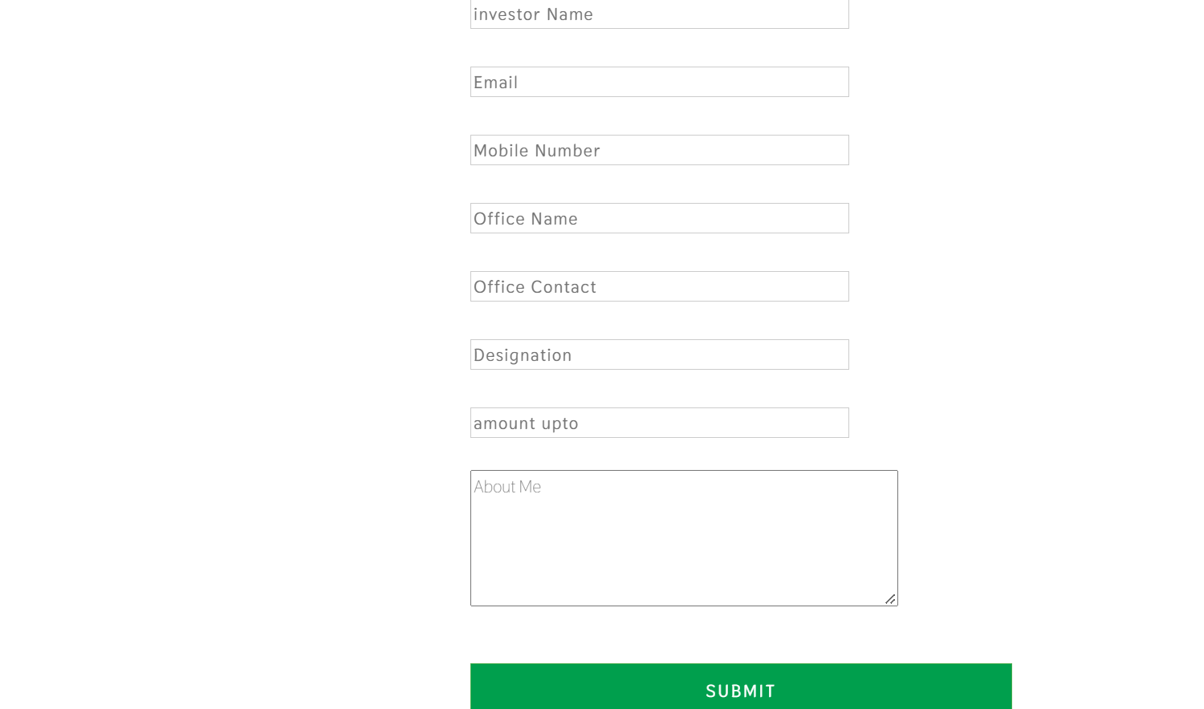

Slide 50
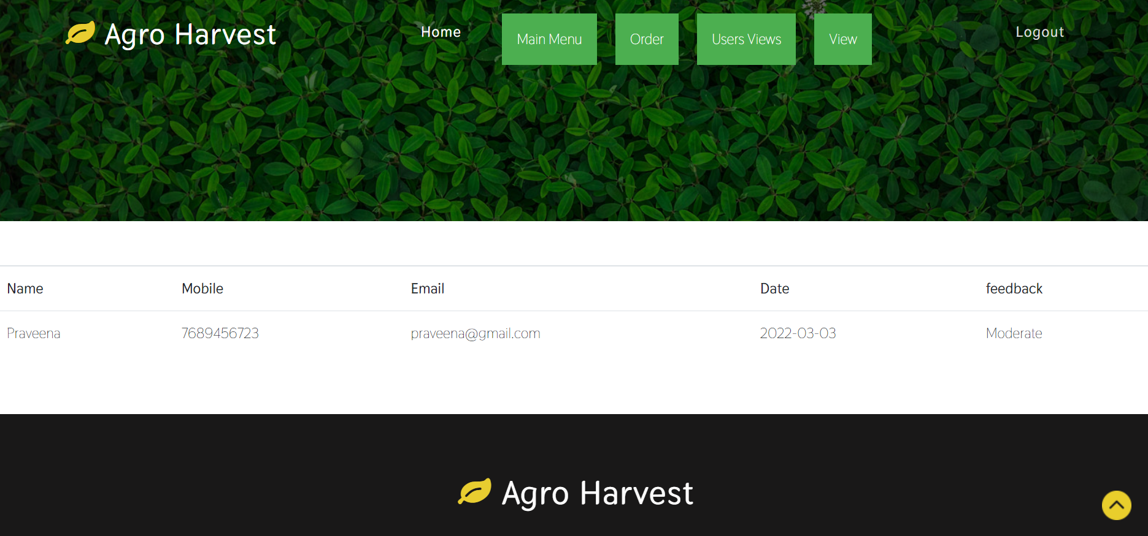

Slide 51
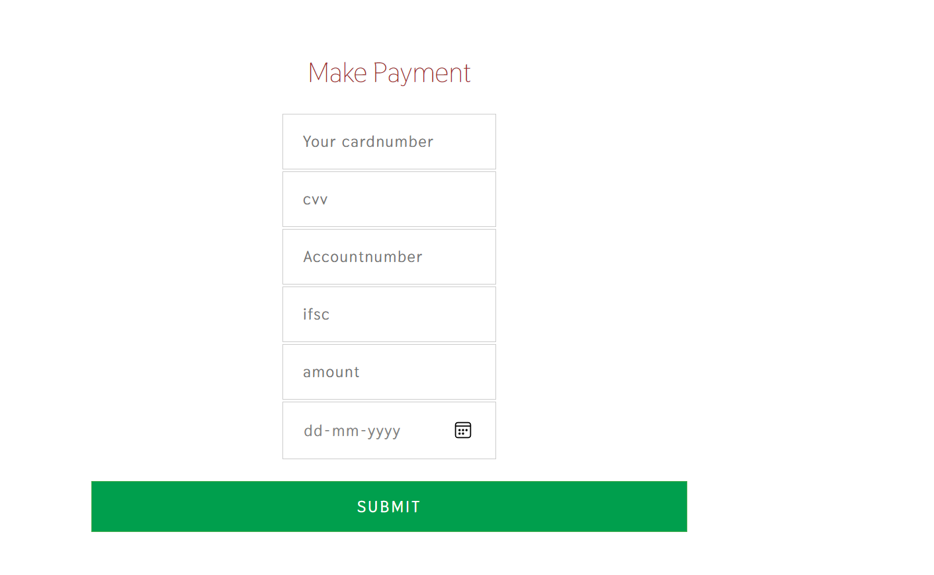
EXPORTER

Slide 52
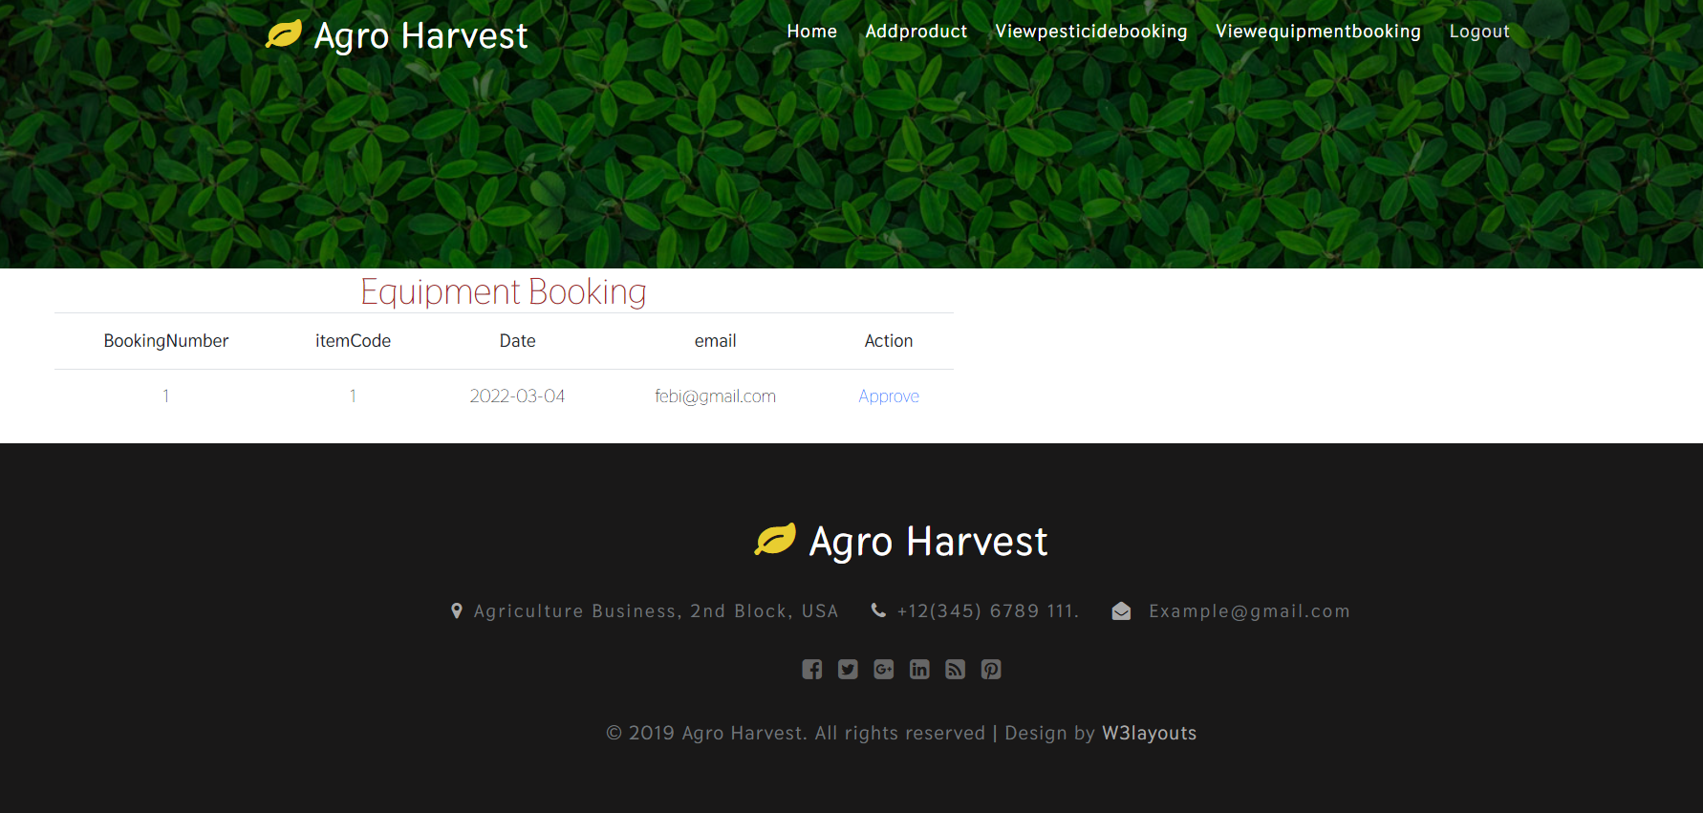

Slide 53
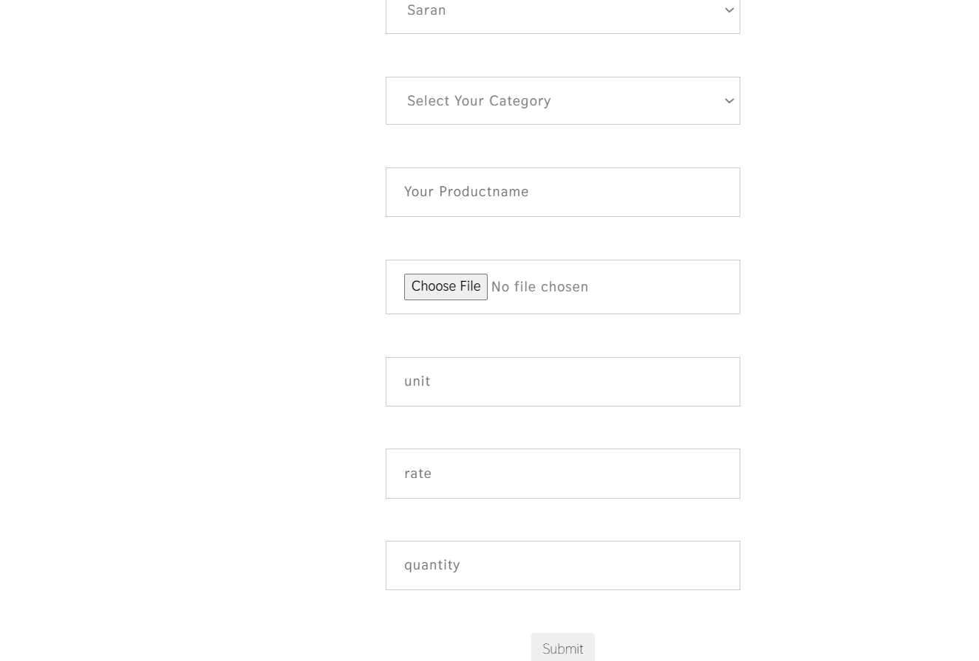
ADD PRODUCT-SUPPLIER

Slide 54
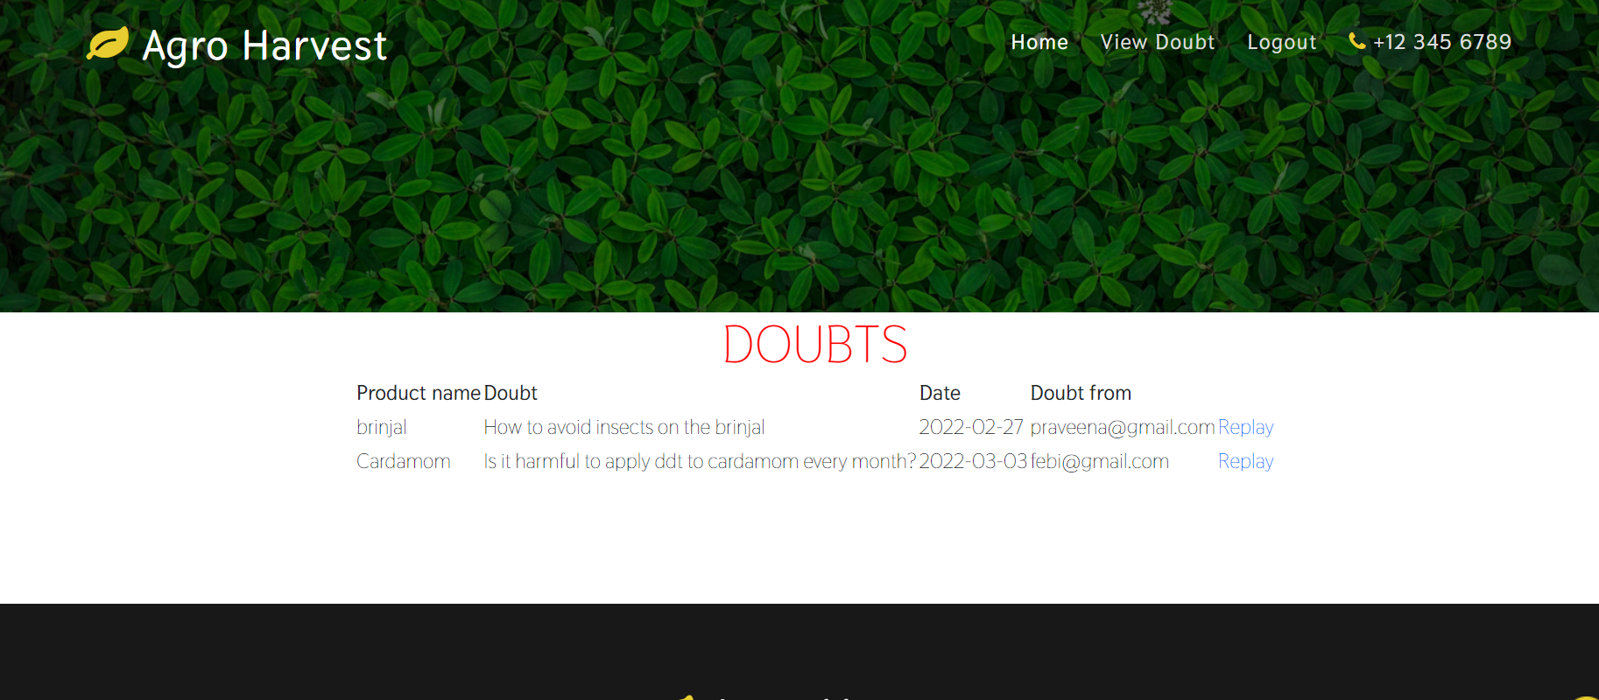

Slide 55
FUTURE ENHANCEMENTS
Cart Management
Bill Integration
Investor Login

Slide 56
CONCLUSION
Farmers Help
Manages different farming requirements like crops, techniques used, selling and buying products etc.
Allows farmers to connect directly with customers and make their transactions profitable for them without a middleman/third party.

Slide 57
REFERENCES
Sindhu M R, Aditya Pabshettiwar, Ketan . K. Ghumatkar, Pravin . H . Budhehalkar, Paresh . V . Jaju, “E-FARMING”, G. H. Raisoni College of Engineering and Management, Pune, India., International Journal of Computer Science and Information Technologies (IJCSIT).
Dr M . Rajarajeswari , “AGRICULTURE MANAGEMENT SYSTEM USING – PYTHON”, December 2019, Journal of The Gujarat Research Society.

Slide 58
Megha Nayak, Pinky Wankhede, Neha Khapekar, Komal Dhote., “E-COMMERCE SITE FOR AGRICULTURE PRODUCTS”.,April 2019, Dept. of Computer Science & Engineering, Nagpur Institute of Technology college, Maharashtra, Nagpur., International Research Journal of Engineering and Technology (IRJET)

